Slide 1
Rental Property Complexities for U.S. Government Employees Overseas
Foreign Service Institute
February 15, 2018

Slide 2
About Your Presenter
Christine Elsea-Mandojana, CPA, CFP®
Certified Public Accountant since 1996
Certified Financial Planner since 2010
MS in Foreign Service/Business Diplomacy from Georgetown University, 1999
KPMG, Arthur Andersen, financial services/non-profit
U.S. expat tax and financial planning since 2006
EFM since 2000: The Philippines, Portugal, Peru, Colombia, DC and currently Barcelona, Spain

Slide 3
Note: This example assumes a primary residence converted into rental status. Other rules apply to vacation homes rented less than 15 days and residences rented > 15 days but used for personal purposes for more than the greater of 14 days or 10% of total days rented.
Rental Properties
Fair Market Rent?
YES
NO
Related Party?
Schedule A with rental income separately reported
YES
Schedule E
NO
Not Renting For Profit Rules

Slide 4
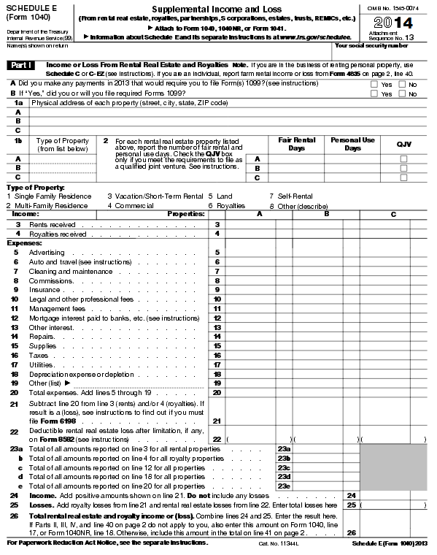
Rental Properties
If part-year primary residence and part-year rental, then allocation required between Schedules A and E
Currently Deductible Expenses
Depreciation from Capitalization
Net Income or (Loss)

Slide 5
Capitalize Versus Expense
Depreciation from Capitalization

Slide 6
Capitalize Versus Expense: The Tangible Property Regulations (TPR)
What Is the Unit of Property (UOP)?
Each building is its own UOP; improvements to a building are not separate UOPs.
For purposes of Improvements, a building structure consists of the building and its structural components but not its building systems.
Structural components: walls, roof, windows, exterior doors, etc.
Building systems: HVAC, plumbing, electrical, escalators, elevators, fire-protection and alarm systems, security systems, gas distributions systems (these are specifically defined under the TPR).
Certain assets within a building are their own UOP—carpet, appliances, etc.
Other considerations—too many to include.

Slide 7
Capitalize Versus Expense: The Tangible Property Regulations (TPR)
What Expenditures Are You Required to Capitalize?
An expenditure is required to be capitalized under the TPR if it meets the Restoration, Adaptation, Betterment, or Improvement criteria (RABI Rules).
Restoration—returns the UOP to its ordinarily efficient operating condition after significant deterioration; rebuilding to like-new condition after end of ADS class life, more!
Adaptation—Adapt the UOP to a new or different use.
Betterment—ameliorates a material condition or material defect; material addition to the Unit of Property (UOP); material increase in productivity or output.
Improvement—Replacing a significant part of UOP, replacing the UOP entirely, replacing the UOP with materials that are more efficient or better quality, improvements paid over more than one year, etc.
NOTE! The amount paid for the expenditure is irrelevant!

Slide 8
Capitalize Versus Expense: The TPR
Capitalization Required Under RABI or M&S Rules?
NO
YES
Expense under De Minimis Election?
Expense with election stmt if applicable
YES
Expense
NO
Expense under Improvement Safe Harbor for Small TP with Bldg Election or Routine Maintenance Safe Harbor?
YES
NO
Capitalize but consider PAD

Slide 9
Safe Harbor Elections: De Minimis Safe Harbor to Acquire or Produce
Applies to Materials and Supplies and Property Acquired or Produced - ex. Coffee maker, garbage disposal, refrigerator, oven, office chairs, computers, printers, office supplies, etc.
With no policy in place by 1/1 of calendar year, up to $200 per invoice/item can be written off instead of capitalized.
With a policy in place by 1/1 of calendar year, up to $2500 per invoice/item (if taxpayer has an applicable financial statement, then max is $5000). The limit prior to 2016 was $500. A written policy is not required but is a good idea, esp. for rentals.
Irrevocable annual election made on paper and filed with return.

Slide 10
Safe Harbor Elections: Routine Maintenance Safe Harbor
Can expense items previously required to be capitalized if routine activity to keep unit of property in its ordinary efficient operating condition.
Considered routine if taxpayer reasonably expects to perform activity more than once in unit of property’s ADS class life (10 years for buildings and building components).
Only applies to amounts normally capitalized under certain restoration provisions (e.g., repaving a driveway).
Does not apply to other improvement items.
No election statement is required.

Slide 11
Safe Harbor Elections: Improvement Safe Harbor for Small Taxpayers with Buildings
Applies to taxpayers with buildings owned or leased with unadjusted basis no greater than $1 million; average annual gross receipts of $10 million or less during preceding three years; and total amount paid for repairs, maintenance, improvements and similar activities during the year do not exceed the lesser of $10,000 or 2% of the unadjusted basis of the building.
Amounts deducted under other safe harbors are included as part of $10k/2% unadjusted basis calculation.
If limits are exceeded, all improvements must be capitalized.
Election is made on paper annually on a timely filed return.

Slide 12
Safe Harbor Elections: Partial Asset Disposition Election
Applies to taxpayers who replace a building, building component or building system or other UOP.
Can elect to write-off the undepreciated value of the replaced UOP.
If do not elect to write-off undepreciated value of replaced UOP then will continue depreciating replaced UOP and depreciate new UOP.
Elect by doing it and completing Form 4797 in the tax return.

Slide 13
Capitalize Versus Expense
Depreciation from Capitalization

Slide 14
Capitalize Versus Expense: The TPR
If you must capitalize, then how do you recover what you paid?
Line 18: Depreciation Expense
Deducting the cost of a capital asset over its useful life (or recovery period as defined by U.S. Treasury Regulations)
Don’t forget possible mandatory bonus depreciation!
How Do You Calculate Depreciation?
Depreciable Basis
divided by
Recovery Period
(apply convention &
In-service date)

Slide 15
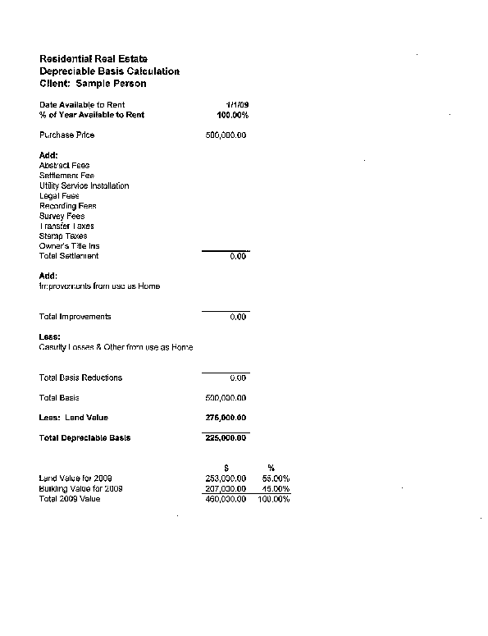
Capitalize Versus Expense: The TPR
Line 18: Depreciation Expense
What is the Depreciable Basis?
Example: Residential Rental
Assume Adjusted Basis > FMV at rental conversion date

Slide 16
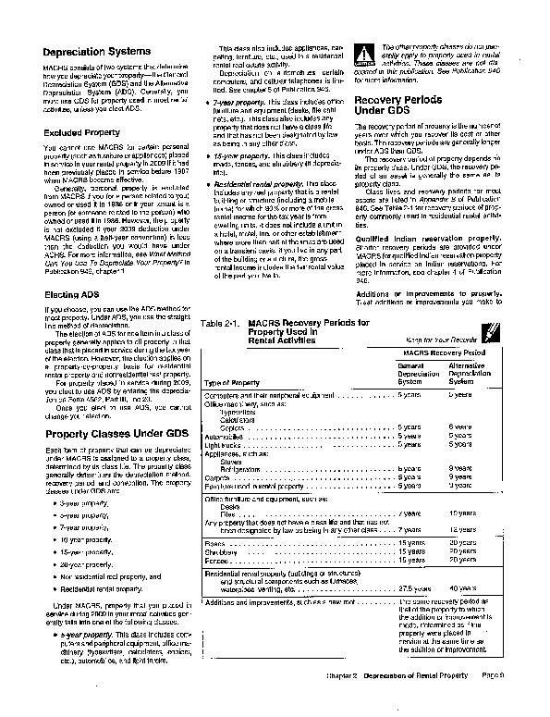
Capitalize Versus Expense: The TPR
Line 18: Depreciation Expense
What is the Recovery Period?
Overseas rental ADS changes to 30 years beg. 2018 under new law
IRS Publication 527
US
Outside
US

Slide 17
Capitalize Versus Expense
Currently Deductible Expenses

Slide 18
Capitalize Versus Expense: The TPR
Examples of Currently Deductible Expenses
Mortgage Interest
Real Estate Taxes
Non-capitalized Repairs (consider TPR requirements)
Management Fees
Commissions
Insurance (in the year paid…not the policy period)
Tax Preparation Fees for Schedule E only
Asset Purchases Expensed Under the De Minimis Safe Harbor Election
RABI Expenditures Expensed Under the Improvement Safe Harbor for Small Taxpayers With Buildings Election or Routine Maintenance Safe Harbor

Slide 19
Capitalize Versus Expense: The TPR
Why Is It Important to Get the Capitalize Versus Expense Decision Right?
New Regulation (§1.1016-3): “A taxpayer is not permitted to take advantage in a later year of the taxpayer’s prior failure to take any such allowance or the taxpayer’s taking an allowance plainly inadequate under the known facts in prior years.” If you capitalize something you should have expensed or vice versa, then the IRS can deny all past and future deductions under audit (i.e., use it or lose it).
You can still fix these issues if you aren’t yet under audit—usually requires Form 3115.
The IRS will only allow you to fix very specific situations if you are already under audit (e.g., wrong class life with negative 481(a) adjustment).

Slide 20
Rental Properties
Is Your Rental Property Loss Deductible?
Possible Deductible (Loss)

Slide 21
Rental Properties
Is Your Rental Property Loss Deductible?
All rental property is a passive activity.
Passive losses can normally only be deducted against passive income.
Exception for cases of Active Participation and MAGI:
MAGI $100k or less then up to $25k of passive rental losses against ordinary income.
MAGI of between $101k and $150k, then phase-out of $25k loss max; amount over max allowed is suspended.
MAGI > $150k, all losses are suspended.
If don’t meet active participation requirement, then all losses suspended.
MAGI limits apply equally to single, head of household or married filing jointly; all losses suspended if MFS.

Slide 22
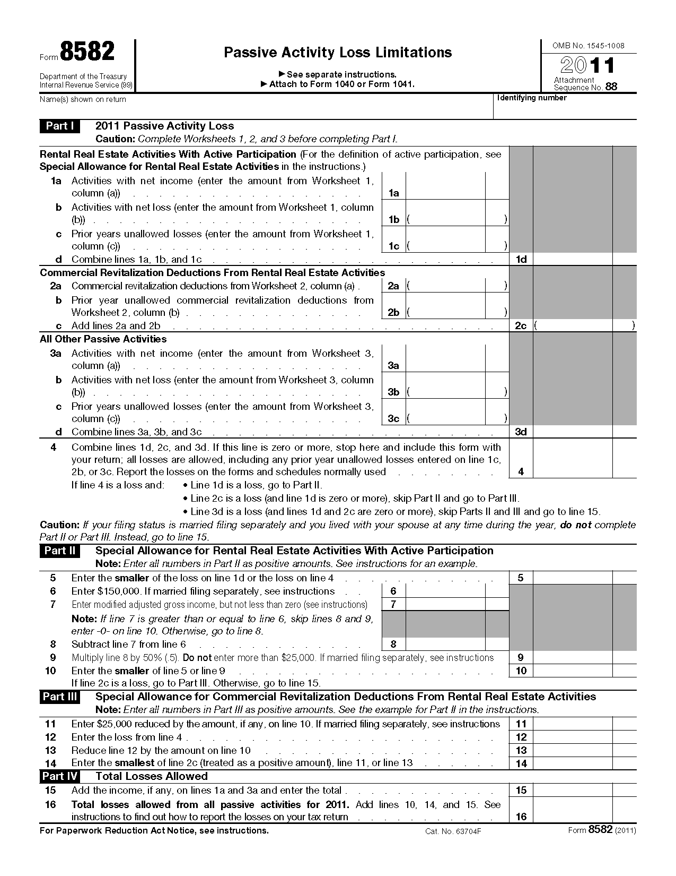
Rental Properties
What Happens to a Loss that Isn’t Deductible?
If non-deductible, losses are suspended and accumulate on Form 8582 until can be used in later year or property disposed of in taxable disposition.

Slide 23
Rental Properties
What Happens When You Sell?
Capital Gains/Losses
Calculated as the difference between the net selling price and the adjusted basis (including land—the adjusted basis must first be reduced by mandatory depreciation and can create Section 1250 unrecaptured gain).
Eligible for the Section 121 gain exclusion rules (including 10-year suspension for eligible EEs); Beware of Unqualified Use periods.
Personal losses are not deductible; portion of loss attributed to business use may be deductible.
Section 1250 Unrecaptured Gain
Created from mandatory depreciation.
Must recapture on the tax return in year of sale up to the capital gain realized (even if no capital gain tax due to Section 121).
Taxed at 25% and never able to exclude it.
Example
Net Sales Price: $200,000
Unadjusted Basis: $100,000
Depreciation: $20,000
Tax Cap Gain:
Net Sales Price: $200,000
Less: Basis - Deprec: <80,000>
Total Cap Gain $120,000
Suspended Losses
Un-suspend in year of sale or taxable exchange.
$100k Poss. 121
$20k 1250 UG

Slide 24
Rental Properties
Tax Cut and Jobs Act Summary
100% Bonus depreciation for qualifying asset purchases acquired and placed in service after 9/27/17; 50% for other.
New IRC 199A deduction for 2018 to 2025—may apply to rental property net taxable income but need regulations to be sure.

Slide 25
Rental Property Complexities for U.S. Government Employees Overseas
Foreign Service Institute
February 16, 2017

